Slide 1
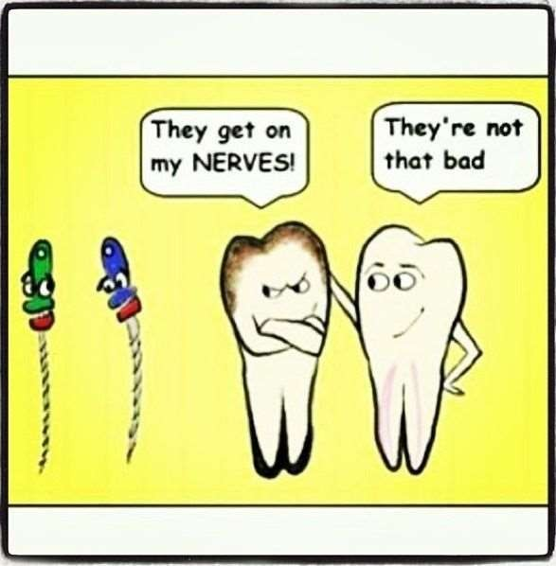
SINGLE VISIT ENDODONTICS

Slide 2
DEFINITION
The conservative non surgical treatment of an endodontically involved tooth, consisting of complete biomechanical cleaning , shaping and obturation of the root canal system during one visit

Slide 3
REASONS FOR ADVOCATING SVE
1. SV – No difference in treatment complications / success rates compared to multiple visit root canal treatments
2. MECHANICAL INSTRUMENTATION – Causes 100 – 1000 –fold reduction in number of bacteria
3. SV – Routine for VITAL CASES - Less post operative pain
– All temporary restorations leak
- in multiple visit, any reduction in bacteria as a result of the 1 st visit will be repopulated with bacteria by the 2nd visit
Success depends on the quality of the root canal treatment & not on the number of treatment visits
Healing is same for vital & non vital cases
Predictable levels of bacterial reduction via refined cleaning & shaping techniques may negate the need for multiple visits

Slide 4
ADVANTAGES
Clinician has a more intimate awareness of the canal anatomy immediately following instrumentation facilitating adequate obturation
No risk of losing important land mark
The canal is never cleaner than immediately after proper instrumentation
No risk of flare-up induce by leakage of the temporary coronal seal between appointments
Teeth are ready for final restoration , diminishing the risk of a facture between appointments ( there by preventing an extraction)
Pt “s pre appointment anxiety & post – operative discomfort are limited to one episode
Time is saved for the pt & for the clinician the treatment is completed in one visit

Slide 5
INDICATIONS
Careful case selection – Vital cases with / without symptoms, vital asymptomatic cases that cannot be well sealed between visits, asymptomatic non vital pulps ( with sinus tracts )
Dentists skill
Time available
Immediate peri radicular surgery
No. of roots – preferably single rooted teeth
Isolation & sealing problems
Anterior aesthetic problems
Restorative considerations

Slide 6
CONTRA INDICATIONS
Nonvital cases with apical periodontitis
Acute apical abscess requiring incision & drainage
Severe pain when tooth is lightly touched
Weeping canals
Insufficient time to complete the procedure
Cellulites
Possible stress on TMJ musculature / psychological stress on pts / clinicians , because of difficult case / longer appointment time / both
Incompetence of the dentist

Slide 7
DISADVANTAGES
No easy access to the apical canal if there is a flare up after obturation
Clinicians fatigue with extended one appointment operating time
Pt fatigue & discomfort with extended operating time
No opportunity to place an intra canal disinfectant other than the use of NaOCL solution – during treatment

Slide 8
PROCEDURE
After case selection – adequate time should be scheduled – to complete the procedure without stress
Required instruments –arranged prior – save time
Anaesthetize the tooth
Isolate – rubber dam
Access cavity preparation
BMP

Slide 9
Disinfection – importance - cleaning- apical 3rd
^{A hybrid technique} - tapered rotaries for crown-down preparation – coronal & middle 3rd – finishing rotary & hand instruments at the apical 3rd

Slide 10
PREPARATION TECHNIQUE
After obtaining straight line access – rotary orifice openers with large tapers – coronal shaping
Smaller tapered – mid root shaping & gaining apical access
Wl – apex locator
Crown – down pressure less technique
Improved irrigation devices – endo activator passive ultra sonic activation , endo vac safety irrigator – ultra Sonics enhances cleaning of root canal systems

Slide 11
Widen the apices- adequate working width – significant coronal flare - space for NaOCL irrigation
NaOCL – conc ranging from 2.6 % to a full 5.25% ( not less than 2.5%)- no apical extrusion
Chlorhexidine 2% - used as a sole irrigant / in combination with NaOCL

Slide 12
OBTURATION
Epoxy resin – anti bacterial & anti fungal properties – as it sets – remaining bact & fungi less viable - most resistance to coronal leakage – polymer structure
Injectable thermo plasticized techniques – time saving
In a single cone system – GP – is not subjected to vertical / lateral condensation – force the point into apical tissues greater taper GP corresponding to the taper of apical finishing instrument – master cone – obturation
Any technique can be used – depending – endodontist competence & requirement of the individual root canal .

Slide 13
Thorough understanding of the basic principles is important in considering each case on an individual basis before making decision as to whether / not it can be completed in one visit .

